Slide 1
Welcome!
Optional instructions: While we setup, please look through the workbook and Sign in
  Workbook: [insert link here or delete]
  Sign- in: [insert link here or delete]
  Evaluations: [insert link here or delete]
Your Facilitators are [insert names here or delete]

Slide 2



Overdose Recognition & Naloxone Administration
Date: [insert date here]
Last Updated: August 2023

Slide 3
Optional: Housekeeping/Instruction Slide for Virtual Platforms

Slide 4
Learning Objectives
Define terms such as adverse childhood experiences, trauma, substance use disorder, opioids, naloxone, & others.
Summarize the current opioid epidemic in Arizona.
Identify the relationship between trauma and substance use.
Recognize signs of an opioid overdose.

Slide 5
Learning Objectives continued…
Show ability to respond to an opioid overdose using naloxone.
Identify aftercare next steps, including where to refer to resources.
Define risk reduction messages and resources to share with clients and communities.
Community Health Worker/Representative Core Competencies:
Communication
Relationship Building
Service Coordination
Capacity Building
Outreach
Knowledge Base
Notes:
.

Slide 6
Brainstorm
What is an opioid?
What have you heard about Naloxone?
What concerns you about using Naloxone?
What are you experiencing in your community?

Slide 7
Opioids
Natural or synthetic chemicals that interact with receptors on nerve cells in the body and brain, and re­duce the intensity of pain signals and feelings of pain.
https://www.cdc.gov/drugoverdose/opioids/terms.html

Slide 8
Definitions Activity
Open Definitions Activity
Match the words on the left with the definitions on the right.
5-6 minutes
1

Slide 9
Definitions Activity 1/2
1. Adverse Childhood Experiences
2. Trauma
3. Substance Use Disorder (SUD)
4. Opioids
5. Fentanyl
B. All types of abuse, neglect, and other potentially traumatic experiences that occur to people under the age of 18.
C. The recurrent use of substances that cause clinically significant impairment, including health problems and failure to meet major responsibilities at work, school, or home.
D. A Synthetic Opioid that is similar to morphine but is 50 to 100x more potent
E. An event or set of circumstances that an individual experiences as physically/emotionally harmful or life threatening and that has lasting adverse effects on the individual’s functioning and mental, physical, social, emotional, or spiritual well-being.
F. Natural or synthetic chemicals that interact with receptors on nerve cells in the body and brain and reduce the intensity of pain signals and feelings of pain. This includes heroin, fentanyl, Hydrocodone, Oxycodone, Morphine, Codeine, and others.
1

Slide 10
Definitions Activity 2/2
6. Naloxone/Narcan
7. Harm Reduction
8. Medication Assisted Treatment (MAT)
9. Peer Support Services
A. The use of medications with counseling and behavioral therapies to provide a "whole patient" approach to the treatment of Substance Use Disorder
G. A set of practical strategies aimed at reducing negative consequences associated with drug use.
I. A medication used to counter the effects of an opioid overdose. Can be inserted nasally or via an injection.
J. Social support services designed to fill the needs of people in or seeking recovery. They are designed and delivered by people who have experienced both Substance Use Disorder and recovery
1

Slide 11
Change the Language by Role Modeling
Instead of these: | Use these:
Clean | Negative (test) Not currently using substances Sterile (needle)
Dirty | Positive (test) A person who is currently using substances Not sterile (needle)
Addict Alcoholic | A person with substance use disorder A person with alcohol use disorder
https://www.whitehouse.gov/sites/whitehouse.gov/files/images/Memo%20-%20Changing%20Federal%20Terminology%20Regrading%20Substance%20Use%20and%20Substance%20Use%20Disorders.pdf

Slide 12
Change the Language by Role Modeling continued…
Instead of these: | Use these:
Abuse Dependence | Drug use If someone is diagnosed by a provider, say Opioid Use Disorder.
Former drug addict | A person in recovery
https://www.whitehouse.gov/sites/whitehouse.gov/files/images/Memo%20-%20Changing%20Federal%20Terminology%20Regrading%20Substance%20Use%20and%20Substance%20Use%20Disorders.pdf

Slide 13

The Opioid Epidemic
Drug overdose is the leading cause of unintentional injury deaths in the U.S. (25-64 yrs).¹
The majority of opioid overdoses happen… at home, alone.²
  5+ Arizonans die per day
  from an opioid overdose.²
Photo by Marina Khrapova on Unsplash
2
1. https://www.cdc.gov/injury/wisqars/pdf/leading_causes_of_injury_deaths_highlighting_unintentional_2017-508.pdf
2. Data from ADHS Jan 2022 Opioid Report: https://azdhs.gov/opioids

Slide 14
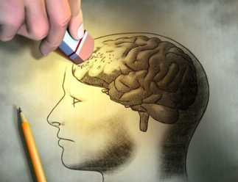
Understanding Addiction
Addiction is NOT a moral failing.
It is a chronic, relapsing brain disease.
  Addiction changes brain functioning and structure.
Hereditary, environmental & social factors contribute.
3

Slide 15

Childhood Trauma & Substance Use
There is a strong correlation between childhood trauma and the development of substance use disorders.¹
ACEs: Adverse Childhood Experiences
Resiliency & Protective Factors help prevent & address ACEs.
3
CDC and Kaiser Permanente

Slide 16

Resiliency Factors
There are positive things that can lessen the impact of ACEs and allow people to adapt to adversity ¹
Approach | Example
Support parents | Identify resources for needs such as rent and child care Connect to parenting classes or support groups
Encourage social supports | Suggest after school programs or clubs
Support positive childhood experiences and relationships² | Mentorship
1: https://www.samhsa.gov/homelessness-programs-resources/hpr-resources/childhood-resilience
2: https://www.npr.org/sections/health-shots/2019/11/05/776550377/cdc-childhood-trauma-is-a-public-health-issue-and-we-can-do-more-prevent-it

Slide 17
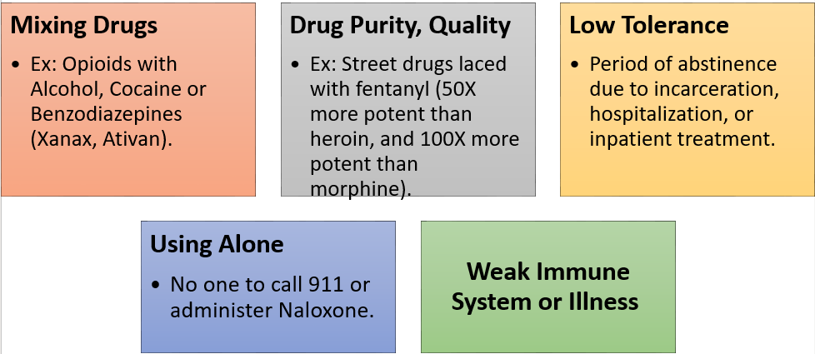
Risk Factors for Overdose

Slide 18
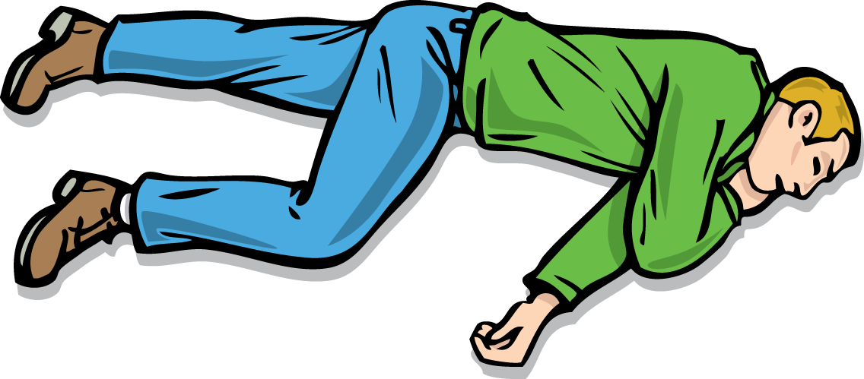
Signs of an Opioid Overdose
Unable to wake
Blue or pale skin, lips, and nails
Very limp body
4

Slide 19
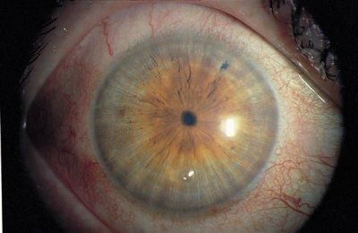
Signs of an Opioid Overdose cont.
Slow heartbeat
Slow/irregular, or absent breathing
Choking, gurgling sound
Pinpoint Pupils
4

Slide 20
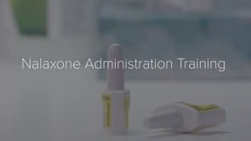
Naloxone Video

Slide 21
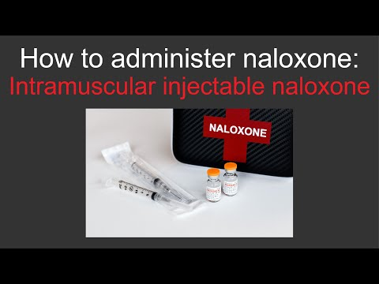

Slide 22
Optional: Stretch Break
~5 minutes
Back at: [insert time]

Slide 23
Skills Practice
Learn how to use Naloxone

Slide 24
Scenario #1
I’m doing a home visit with my client, Esperanza. After talking with her for a few minutes, she seems “out of it” for the appointment. She talked about how her chronic pain has been bad and took more medications to help. Then she passes out!
I try to wake her up, but she doesn’t respond to my voice, and she doesn’t respond when I shake her.
What should I do?
Notes:
Feel free to use an alternative scenario from the list or create your own to be more relevant to your audience.

Slide 25
Recap
Sternum Rub
If no reaction, Call 911 and give Naloxone
Rescue breathing. Follow 911 dispatcher instructions
After Naloxone, stay with the person for at least 3 hours or until help arrives.
Photo from www.azdhs.gov/opioid,
Opioid Safety and Naloxone Use
5

Slide 26
Scenario #2:
You’re at home. You answer a knock at the door from a young friend who lives next door. He looks worried, “We were hanging out and Ricardo took some pills. He isn’t waking up, and he is breathing funny. Can you help?”
You think it’s an opioid overdose.
You remember you have an old naloxone kit in your drawer. It’s expired! Oh, well! You grab it and run over to help Ricardo.
What should you do?

Slide 27
Recap
Sternum Rub
If no reaction, Call 911 and give Naloxone
Rescue breathing. Follow 911 dispatcher instructions
After Naloxone, stay with the person for at least 3 hours or until help arrives.
Photo from www.azdhs.gov/opioid,
Opioid Safety and Naloxone Use
5

Slide 28
Let’s return to the Parking Lot

Slide 29
911 Good Samaritan Act*
Arizona Revised Statute (ARS) 13-3423
2018: a person cannot be prosecuted for drug or paraphernalia possession if:
  The person (a “Good Samaritan”) was seeking medical help for someone believed to be suffering from an overdose; and
  Drugs or paraphernalia are discovered as a result of the request for medical assistance.
The person who has overdosed and for whom a request for medical help is made by a “Good Samaritan” cannot be charged or prosecuted for drug or paraphernalia possession.
*Seek legal assistance for guidance.
5
Notes:
Purpose: Arizona voted in the Good Samaritan Act in 2018 and it is now in effect. Important that officers understand this new law and discuss with their supervisors.
Maybe put in disclaimer (only certain amounts allowed and no other evidence for non-drug criminal offenses is allowed)

Slide 30

Possible Effects of Naloxone
Can cause an opioid withdrawal
  Fatigue
  Fever/sweating
  Loss of bowel/bladder function
  Upset stomach/vomiting
  Confusion, disorientation, irritation
  Increased heartrate/breathing
  Pain/aches
5

Slide 31
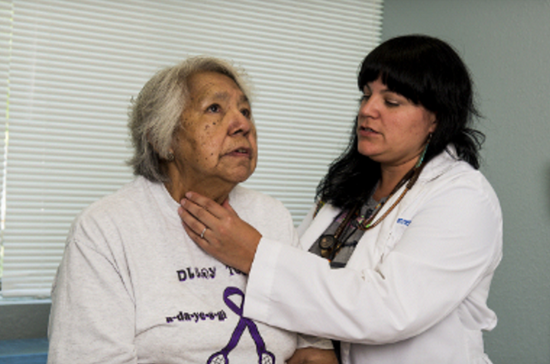
Aftercare 1
If the person cannot walk/talk
well, it is important for EMS to
take them to the hospital.
Some individuals refuse medical care
If possible, someone should stay with the person for several hours and keep them awake.
Overdose is terrifying!
Overdose often catalyzes an individual to get help!
https://www.ncbi.nlm.nih.gov/pmc/articles/PMC3739053/
https://harmreduction.org/issues/overdose-prevention/overview/overdose-basics/responding-to-opioid-overdose/aftercare
6

Slide 32

Aftercare 2
Naloxone can last 30-90 minutes.
Another overdose could happen whether additional opioids are taken or not.
Naloxone will not cause an overdose
Naloxone does not work on overdoses from other substances
Adverse effects are unlikely even when Naloxone is administered to someone not overdosing on opioids
6
https://www.ncbi.nlm.nih.gov/pmc/articles/PMC3739053/
https://harmreduction.org/issues/overdose-prevention/overview/overdose-basics/responding-to-opioid-overdose/aftercare

Slide 33
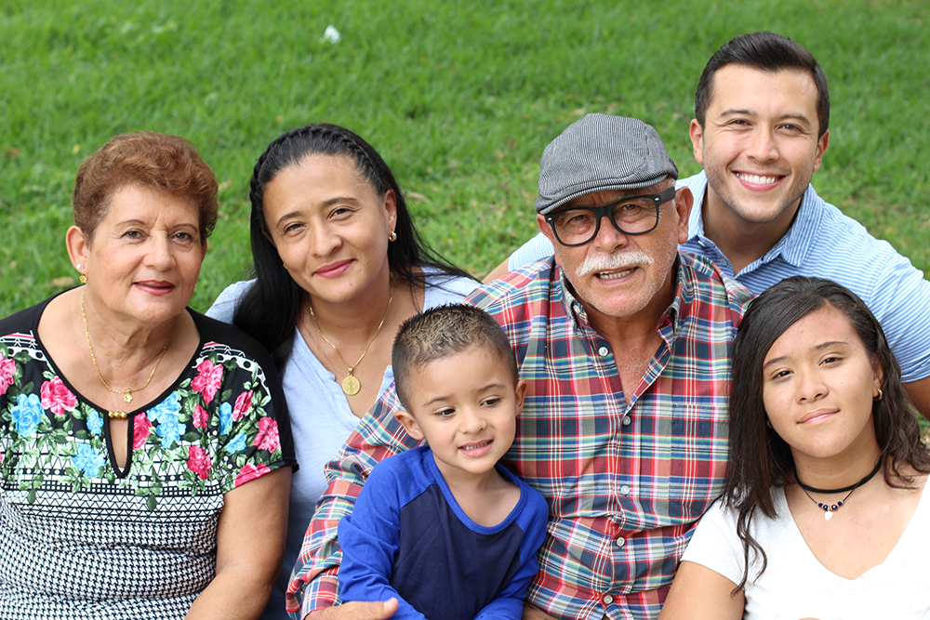
Community Resources in Arizona
Go to 211arizona.org (call Arizona 2-1-1) or Arizona Opioid Assistance & Referral Line: 1-888-688-4222
Find local Rx Drug Drop-Off Locations: www.azdhs.gov/gis/dump-the-drugs-az/
Find Local treatment Services: findtreatment.samhsa.gov
Optional additional resource or delete
Optional additional resource or delete
Optional additional resource or delete
6
Notes:
Purpose: Re-emphasize resources they were given at the beginning of the training.

Slide 34
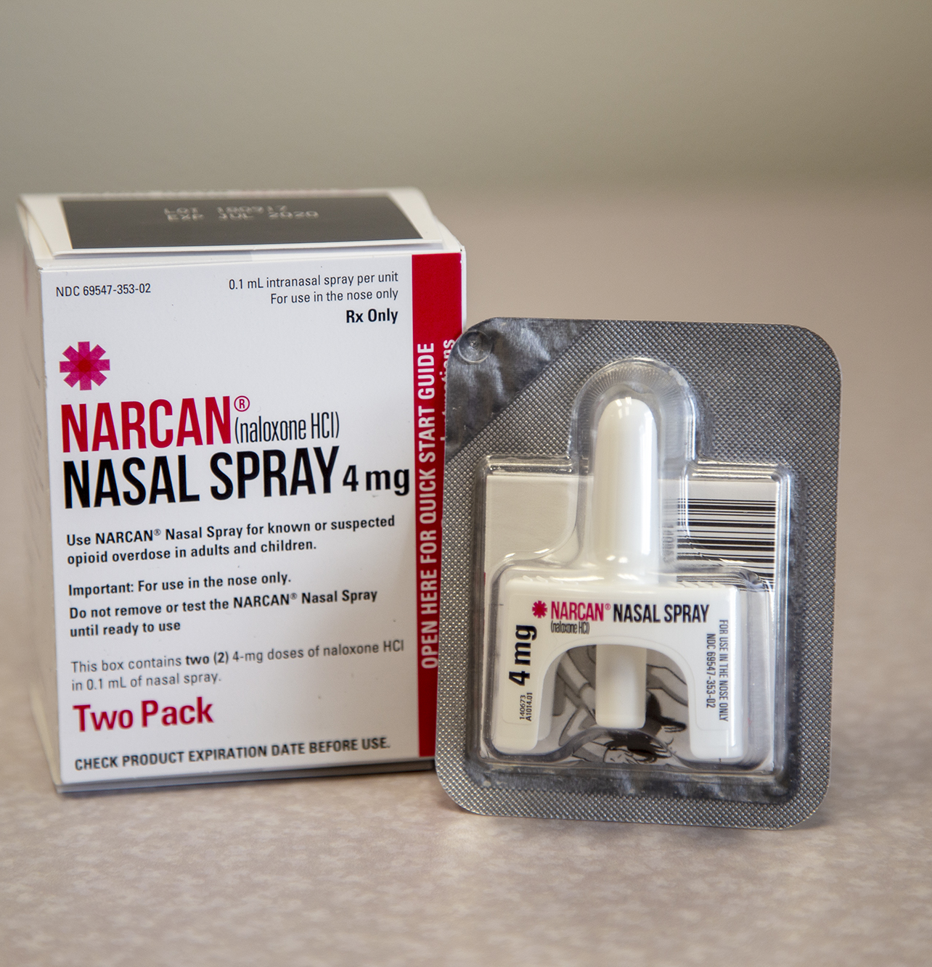
Where to Find Naloxone
1.Become a naloxone distributor, contact the Arizona Department of Health at: https://www.azdhs.gov/opioid/#naloxone
2.Find naloxone near you at: aznaloxone.org
3. Contact Sonoran Prevention Works: https://spwaz.org/get-supplies/
4. Naloxone may be available for a copay or no cost with your insurance under the standing order.
5. Over the Counter availability coming soon!
Notes:
Purpose: Re-emphasize resources they were given at the beginning of the training.

Slide 35

Why don’t people get help?
Limited treatment options
Stigma: Drug addiction is the most
stigmatized issue in the world¹
Accepting “I have a disorder”
Treatment Affordability, Accessibility
Fear of withdrawal, arrest, isolation
Don’t know where to go for help
Unsuccessful attempts at quitting
Losing things like a job, housing, relationships
1. World Health Organization, 2001
7
Notes:
Purpose: Important to stress that getting help is not as easy as it may seem. Might be the opportunity to mention new funding and opportunity for people to use evidence based treatments like MAT.

Slide 36

Relapse & Recovery
Relapse & remission are a normal part of the disease.
It can take years for someone to commit to treatment and recovery.
Recovery may be a life-long process for some.
7
Notes:
Lots of “Healing isn’t linear” messages that could also be helpful (if appropriate)

Slide 37
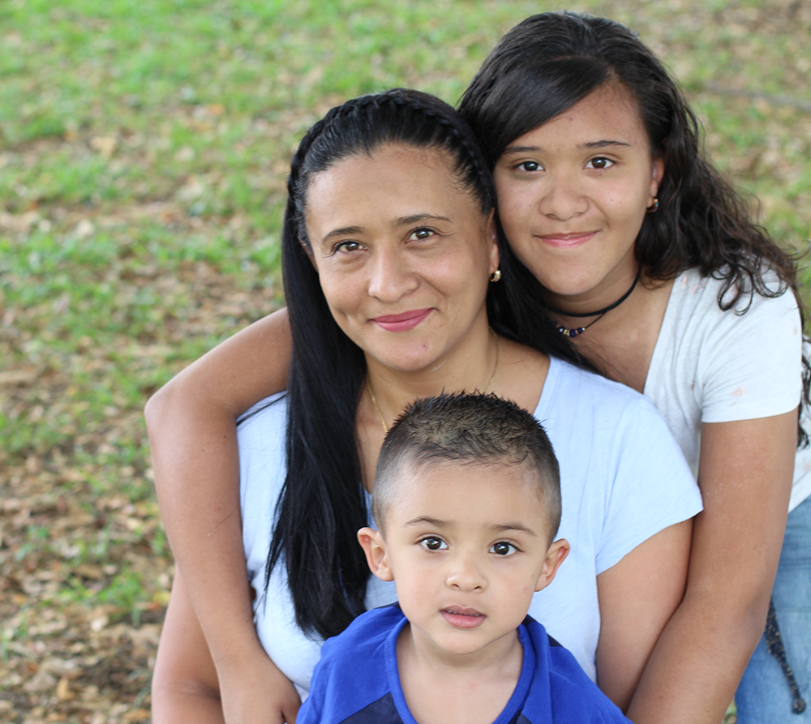
Relapse & Recovery Cont.
Relapse/return to use may be part of the recovery process and is common among those who participated in treatment programs, with relapse/reoccurrence rates between 40-60%, similar to other chronic diseases (diabetes, asthma, hypertension).
  National Institute on Drug Abuse
Notes:
Purpose: It’s not just theory, but the data reveals the close relationship between trauma and substance use disorders. Why does this matter? You’re not dealing with a criminal. This is a person with a story and a medical condition.

Slide 38

How to Offer Support
Use motivational interviewing skills.
Remember we are not here to diagnose.
Recognize when and how to refer.
Use person first language.
Recognize who is at high risk for overdose and offer harm reduction tips.
7

Slide 39
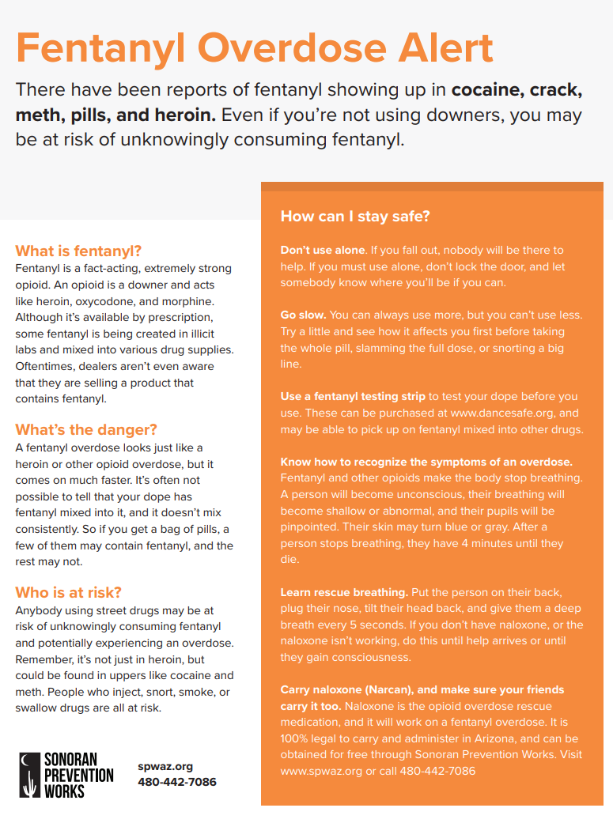
Harm Reduction Tip Sheet
Don’t use alone.
Go slow.
Use a fentanyl test strip.
Know how to recognize the symptoms of an overdose.
Learn rescue breathing.
Carry Naloxone.
7

Slide 40
Take Action
Stay Safe and Protect Others
Take COVID-19 Mitigation Measures
Use Treatment & Recovery Services
Use
telemedicine
Attend virtual group sessions
Get the vaccine & booster
Get tested
Stay
hydrated
Use
treatment
Connect to mental health & social services
Mask up
Follow physical distance
Learn more about social connectedness here: www.hhs.gov/surgeongeneral/priorities/connection/index.html
Quarantine
Reduce stigma
Notes:
When the pandemic started there were elevated levels of depression and anxiety. Social Isolation caused an increase in depression. Fortunately, we have the tools to fight against COVID-19. Those include getting vaccinated and boosted, wearing a mask, physical distancing while socially connecting, getting tested frequently, ( if getting a positive result, then following the quarantine and isolation measures), and staying at home if feeling sick. Together we can also promote self-care – mental health practices such as (list some of the items here from the slide). We strongly recommend to advise your communities / patients / clients to check your local health department for updates as these guidelines continue changing.

Slide 41

An Epidemic within a Pandemic:
The Impact of COVID-19 on Substance Use Disorder
People with SUD are
8.6 x's more likely to contract COVID-19
COVID-19 and the substance use disorder epidemic put those with SUD at higher risk for illness and death from COVID-19.
The disruption to daily life due to the COVID-19 pandemic has disproportionally affected those with SUD, seeking treatment and in recovery.
https://www.ncbi.nlm.nih.gov/pmc/articles/PMC7488216/
Notes:
Overlapping Mechanisms
People diagnosed with an SUD during the pandemic are eight times more likely to require hospitalization and die from COVID-19 than those without an SUD. People with SUDs often have weakened lung function, which immediately puts them at increased risk of contracting and suffering worse outcomes from COVID-19. The hallmark symptom of an opioid-related overdose is decreased respiration. COVID-19 is caused by severe acute respiratory syndrome coronavirus-2, may impair the immune system and/or cause neuroinflammation, this could decrease the successfulness of the COVID-19 vaccines.

Slide 42
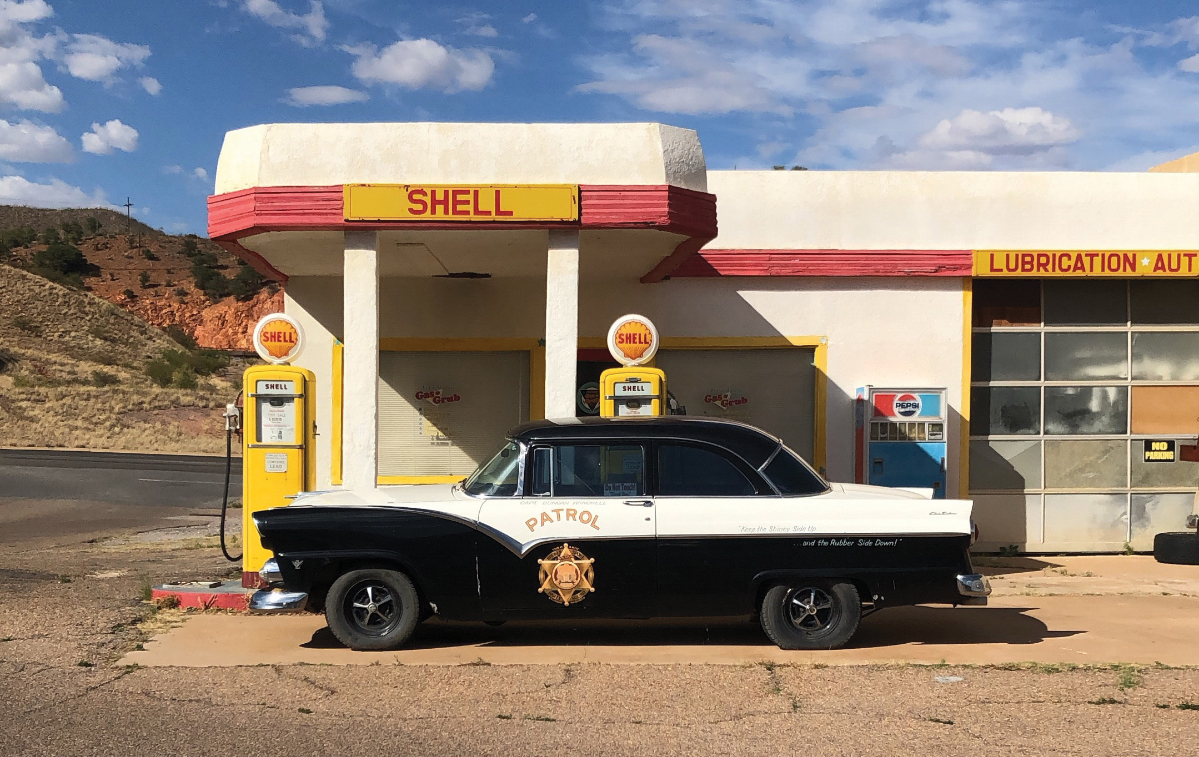
Parking Lot
Looking back at our parking lot, what questions do you still have? What are you still unsure about?
Image Credit: Melissa Quezada, AzCRH
7
Notes:
Going to ask Paul for some images: ideally Latinx/Native American providers

Slide 43
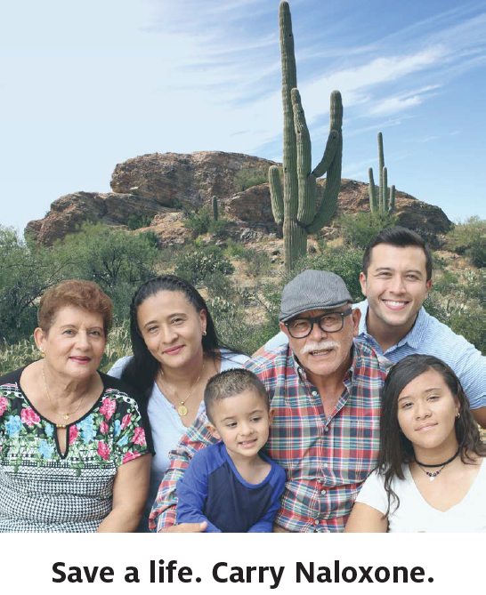
Remember
People who use drugs aren’t bad people.
Substance Use Disorder is a chronic relapsing brain disease.
Naloxone reverses an opioid overdose.
We can meet people where they’re at and not leave them there.
Notes:
>Collect Evals

Slide 44
Additional information and resources here: crh.arizona.edu
Email: azcrh-od2a@arizona.edu

